Slide 1

TECHNICAL SEMINAR
RADARS: HISTORY, PHYSICS & LIMITATIONS
Complete Technical Overview
Gene Soudlenkov, GNZ, 2025

Slide 2



Briefing Agenda
01 // Origins
02 // Physics
03 // Modern Tech
Pre-electronic detection and the birth of radar.
Range, Doppler, Pulse Mechanics, and Gating.
AESA, Stealth, and Civilian Applications.

Slide 3

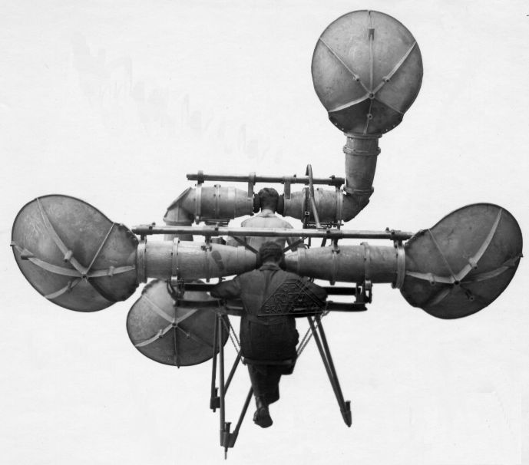
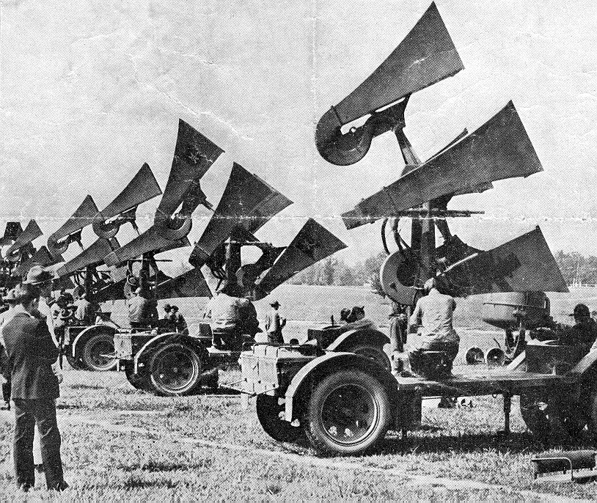
1915-1940s: Aeroacoustics – early devices
Supplement to visual means for the artillery
Usually contain four sound-absorbing elements, such as curved shells or horns that are used in pairs. Two elements at a fixed mutual distance were adjustable in the horizontal plane for the determination of the map angle. The other two shells or horns could be adjusted in the vertical plane to measure the elevation
- The detection of unseen incoming aircraft was a major problem
- After a sound contact was made, laborious calculations were then required
- It was the only system available for detecting the approach of unseen aircraft until the development of radar in the 1930
- According to the Imperial War Museums, this device had a maximum accuracy of 1/10 of a degree
Notes:
Since WW1 it had been realised that the threat of attack by air was very real. In WW1 the UK had suffered over fifty bombing raids from German Zeppelin airships, and later Gotha bomber aircraft, on London, Great Yarmouth, Ramsgate and others, with a total of 1,392 civilian dead and 3,330 injured, and it was evident that there was no effective means of providing early warning against such raids. The earliest attempts used a network of observers, and acoustic techniques based on large horns or reflectors, but these only worked at all when conditions were optimal. The pictures below show some schemes of this kind.
Everything cooperating, the aircraft would probably be heard 8 miles away, could, infrequently be heard at sixteen miles, and the record for the course was about twenty-four – I do not know that the Big Ear ever detected a wholly unexpected aircraft approaching from the most favourable direction at this latter range. All this was, moreover, conditional on the visitor keeping to the fairway.

Slide 4
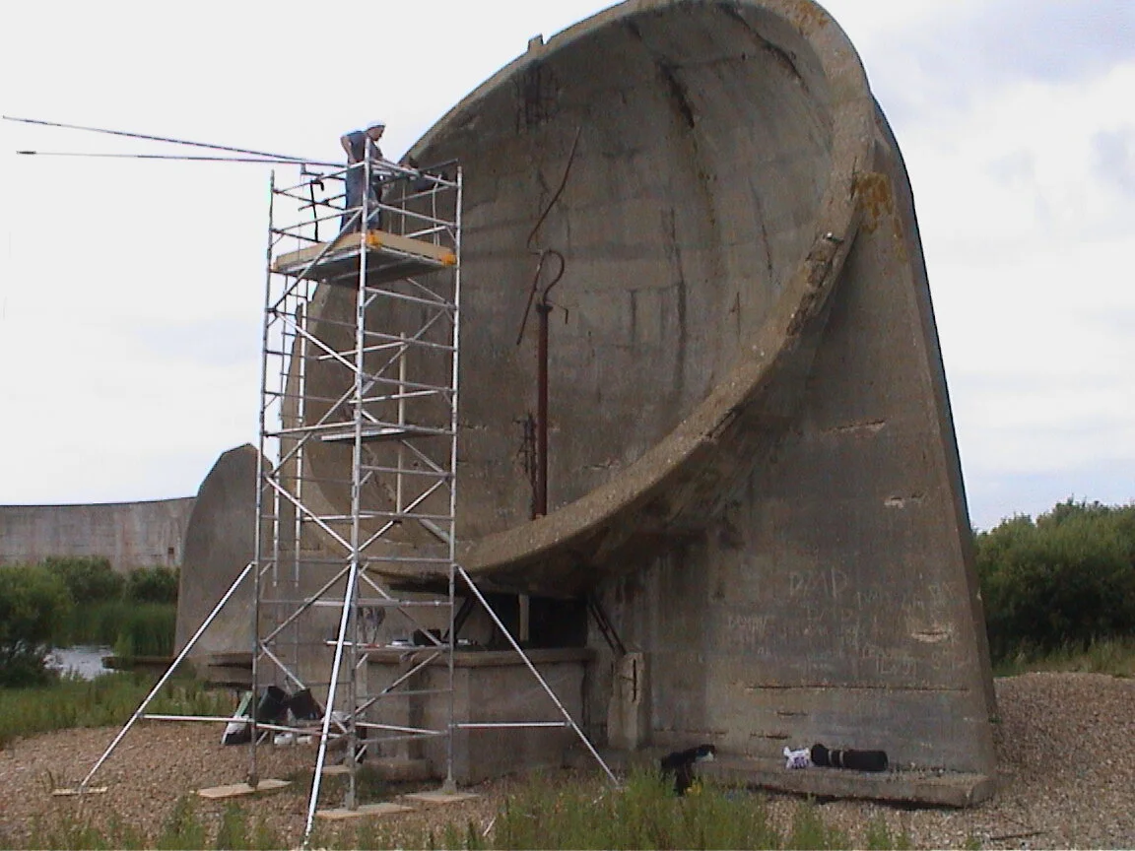
Pre-Radar: Listening for Engines
Acoustic Mirrors
Before radio waves, defense relied on sound waves.
Huge concrete dishes focused the sound of incoming aircraft engines to a microphone. The limitation was the speed of sound—by the time you heard them, they were already close.

Slide 5

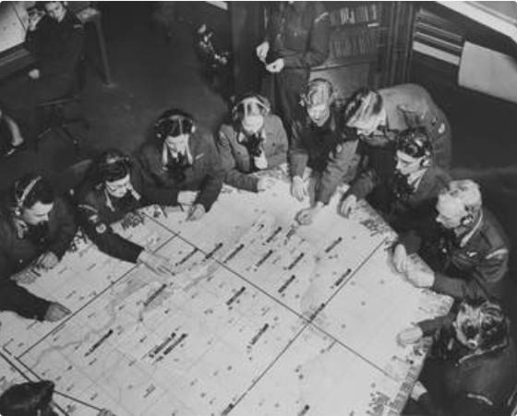
The Royal Observer Corps
The Human Sensor Network
Without radar, Britain relied on thousands of volunteers with binoculars. They phoned sightings into a central filter room.
Fatal Flaw: Useless at night or in cloud cover.

Slide 6
History
1900 Nicola Tesla suggested that the reflection of electromagnetic waves could be used for detecting of moving metallic objects.
1904 The German engineer Christian Hülsmeyer invents the "telemobiloscope" for a traffic monitoring on the water in poor visibility. This is the first practical radar test. Hülsmeyer apply his invention for a patent in Germany, France and the United Kingdom.
1921 The invention of the Magnetron as an efficient transmitting tube by the US-american physicist Albert Wallace Hull.
1922 The American electrical engineers Albert H. Taylor and Leo C. Young of the Naval Research Laboratory (USA) locate a wooden ship for the first time.
1930 Lawrence A. Hyland (also of the Naval Research Laboratory), locates an aircraft for the first time.
1931 In Britain the first known proposal for radar system came from William A. S. Butement and P. E. Pollard in January 1931. They equipped a ship with radar. As antennas were used parabolic dishes with horn radiator. Although their equipment produced short-range results the work was abandoned for lack of government support.
1933 On the basis of the in 1931 from himself invented sonar, Rudolph Kühnhold presented a so-called “Funkmessgerät”. It worked on a wavelength of 48 cm and the transmitter had a power of about 40 Watts. From these tests, the Freya-radar was developed, which was produced in series beginning in 1938.
1935 Robert Watson-Watt (later: Sir Robert) suggested that radio waves might be used to detect aircraft at a distance and outlined a means of doing so. Intensive research began and by 1939 Britain possessed a defensive chain of highly secret Radio Direction Finding (RDF) stations.

Slide 7

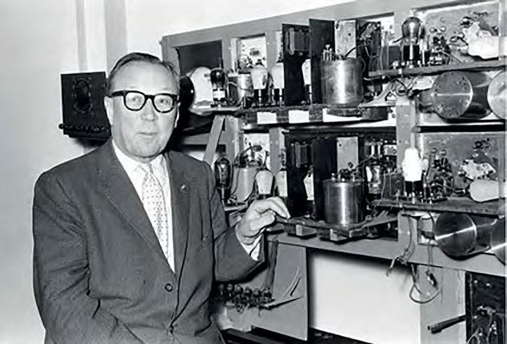
The "Death Ray" Myth
1935: A Critical Pivot
The British Air Ministry asked Robert Watson-Watt if radio waves could boil a pilot's blood (a Death Ray).
The Calculation: Power requirements were impossible.
The Solution: "But," Watson-Watt said, "if you send a pulse, I can detect the reflection."

Slide 8

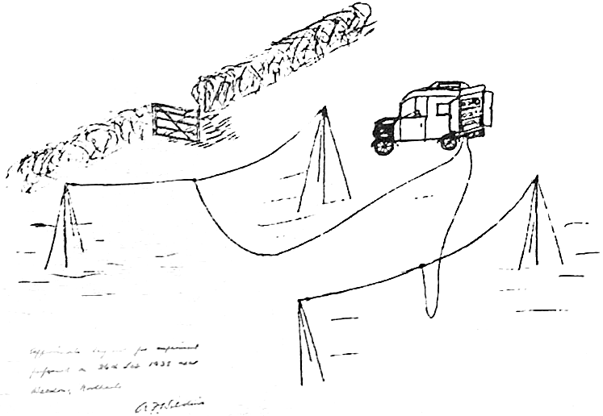
Proof of Concept: Daventry
February 26, 1935
>
Source: BBC Shortwave transmitter at Daventry.
>
Target: Heyford bomber flying in the beam.
>
Result: A distinct oscillation on a cathode ray tube caused by the aircraft's interference pattern.
>
Significance: The birth of practical RAdio Detection And Ranging.

Slide 9
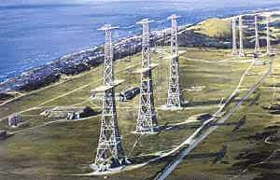
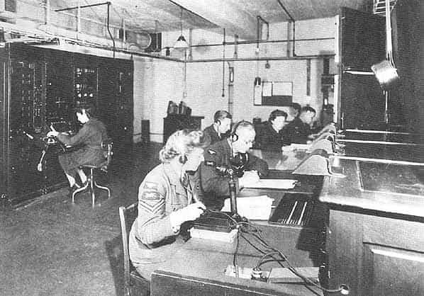
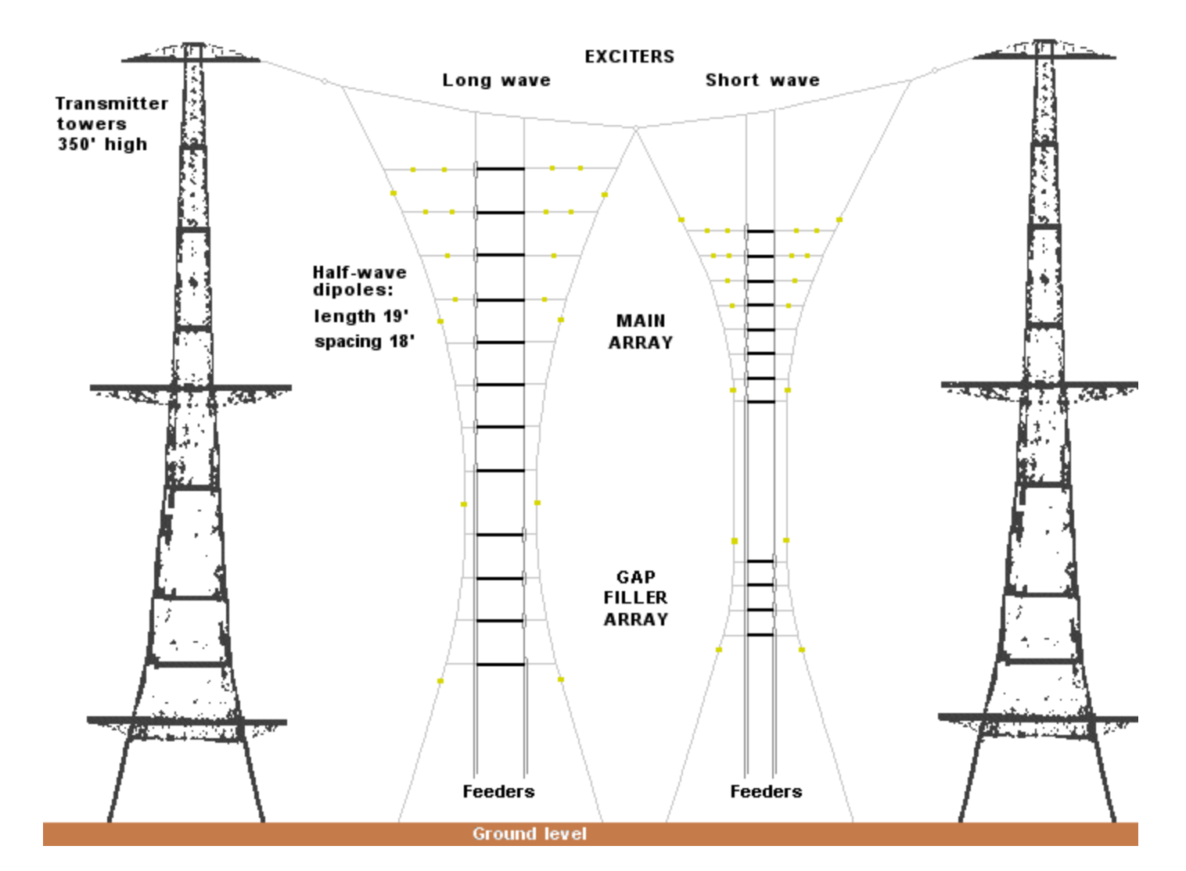
Chain Home (1937)
RADAR: Radio Detection and Ranging
The First Network
These were not rotating dishes. They were massive steel towers that "floodlit" the entire sector with radio energy.
They operated on very low frequencies (HF), which required huge antennas to work.

Slide 10



Radar Configurations
Bistatic
Monostatic
The Duplexer
Transmitter and Receiver are far apart (e.g., Chain Home). Complex geometry but receiver is isolated from high power.
Tx and Rx are co-located or share the same antenna. The modern standard.
The device that switches the antenna from Transmit to Receive in microseconds, enabling monostatic radar.

Slide 11
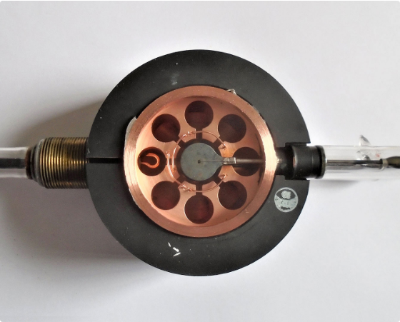
The Cavity Magnetron
Shrinking the Radar
Early radars were building-sized. To put radar on a plane, you needed high power in a small package.
The Magnetron (1940) was the breakthrough. It generated high-power microwaves, allowing small dishes to fit in aircraft noses.

Slide 12
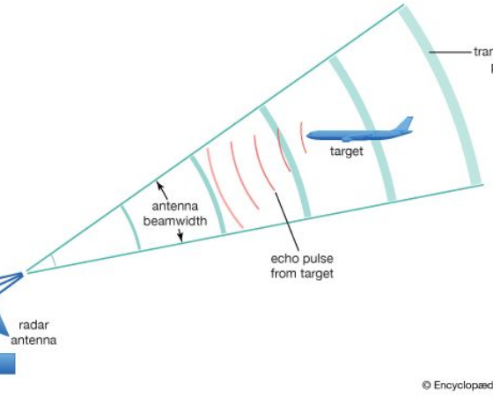
The Echo Principle
Radio Echoes
Radar is simply an echo in the radio spectrum.
1. Transmit a loud burst of energy. 2. Wait. 3. Detect the tiny fraction of energy that bounces off the target.

Slide 13

Measuring Distance
Time of Flight
Distance = (Speed of Light × Time) / 2
We divide by 2 because the signal has to travel to the target AND back.

Slide 14



The Radar Equation (Variables)
Power (Tx)
Gain (G)
Sigma (σ)
How loud you shout. More power = more range.
How focused the beam is. A flashlight goes further than a candle.
The Radar Cross Section. How reflective the target is.

Slide 15
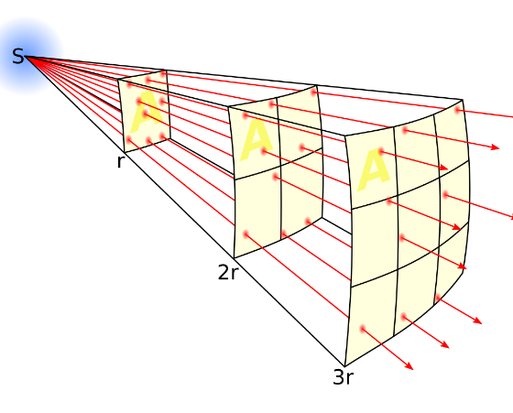
Signal Fading (1/R^4)
The Double Fade
Radar signals fade incredibly fast. The energy spreads out on the way there (1/R²), and spreads out again on the way back (1/R²).
Result: To double detection range, you need 16 times more power.

Slide 16
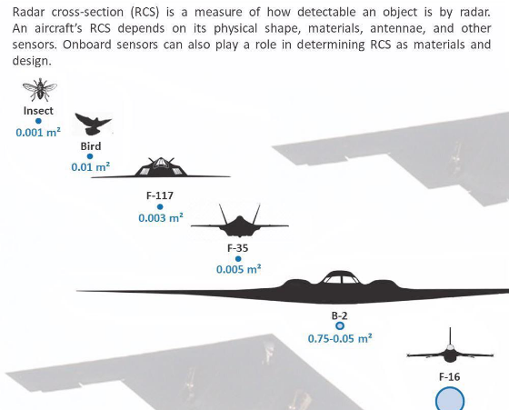
Radar Cross Section (RCS)
Electronic Size
RCS measures how well an object reflects radar. It is not the same as physical size.
A jumbo jet has a huge RCS. A stealth bomber, despite being large, has the RCS of a marble.

Slide 17
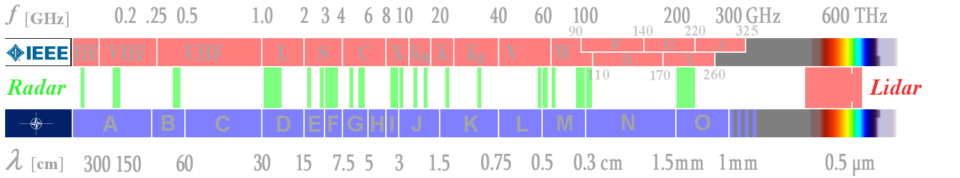
Frequency Bands
Band | Use Case | Characteristic
HF / VHF | Early Warning | Long range, low accuracy. Can see stealth.
L / S Band | ATC, Search | Balanced range and precision.
X / Ku Band | Fire Control | Short range, pin-point accuracy.

Slide 18
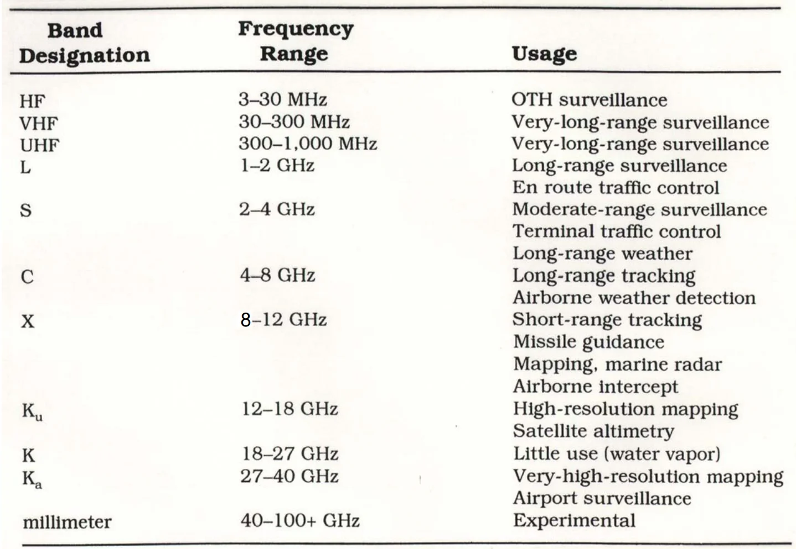
Frequency Bands (cont)

Slide 19
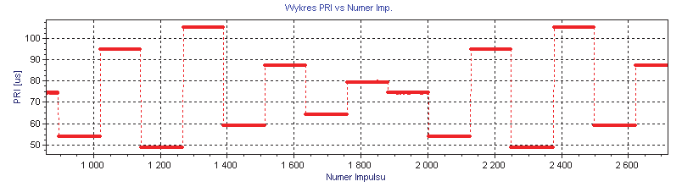
The Pulse Train
Transmit and Listen
Radar cannot transmit and listen at the same time. It fires a burst (Tx) and then listens (Rx).
Duty Cycle: Radars spend 99% of their time listening and only 1% transmitting.

Slide 20
PRF vs. PRI
PRI
PRF
The Trade-off
Pulse Repetition Interval. The time from the start of one pulse to the next.
Pulse Repetition Frequency. Pulses per second.
High PRF = Better velocity update. Low PRF = Longer range.

Slide 21
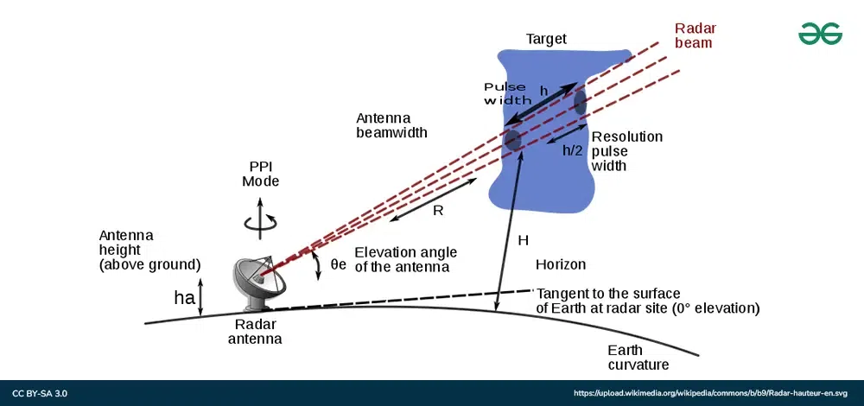
Resolution pulse width
Range resolution is the ability of radar to separate two targets that are close together in range and are at approximately the same azimuth. The range resolution capability is determined by pulse width.
A radar pulse in free space occupies a physical distance equal to the pulse width multiplied by the speed of light, which is about 984 feet per microsecond. If two targets are closer together than one-half of this physical distance, the radar cannot resolve the returns in range, and only one target will be displayed.

Slide 22

Range Ambiguity
The "Second Time Around" Echo
If a target is too far away, its echo might arrive after the radar fires the next pulse.
The radar assumes the echo belongs to the second pulse and displays the target as being very close (a ghost target). This limits the Maximum Unambiguous Range.

Slide 23

Pulse Width (Tau)
Energy vs Clarity
>
Long Pulse: Contains more energy. Can see further.
>
Short Pulse: Provides better resolution. Can distinguish close targets.
>
Problem: You usually want both.

Slide 24
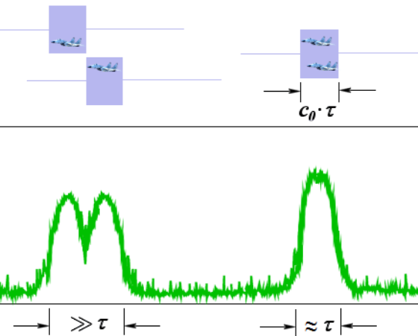
Range Resolution
Resolving Targets
If two planes are flying closer together than half the pulse length, the radar sees one big "blip."
Short pulses are required to separate formation flights.

Slide 25

Solution: Pulse Compression
Chirping
How to get long range (energy) AND high resolution (short pulse)?
Technique: Transmit a long pulse that changes frequency (chirp). The receiver "compresses" this chirp mathematically into a sharp spike.

Slide 26
Minimum Range (Blind Zone)
The Receiver is Off
While transmitting the pulse, the receiver is disconnected to prevent damage.
This creates a "Blind Zone" around the radar. Any target close enough to return an echo before the pulse finishes cannot be seen.

Slide 27
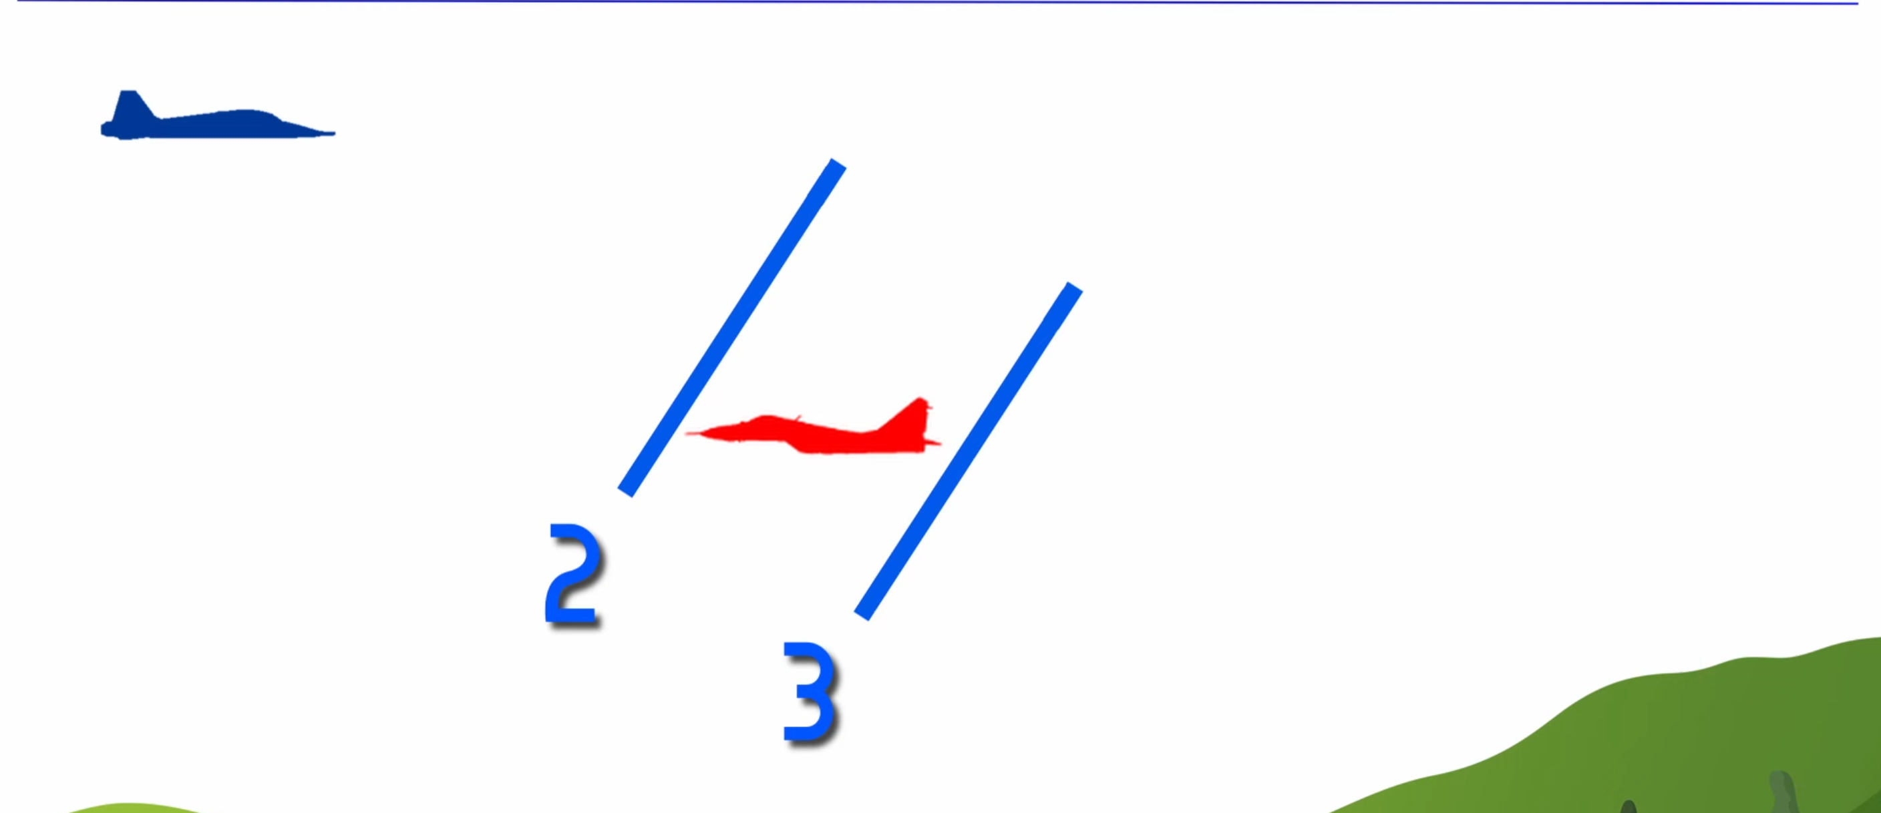
Range Gating
Slicing Time
The receiver chops the listening time into small buckets called Range Gates.
If an echo falls into "Gate #50", we know exactly how far away it is. This allows the processor to ignore noise from all other gates.

Slide 28

Antenna Gain
Focusing the Energy
An isotropic antenna radiates everywhere (like a candle). A radar antenna focuses energy (like a flashlight).
Gain is the ratio of focused power vs isotropic power. High gain = longer range.

Slide 29
Azimuth Measurement
Scanning
Traditional radars rotate 360 degrees.
The target's direction (Azimuth) is determined by the direction the antenna is pointing at the exact moment the echo is received.

Slide 30
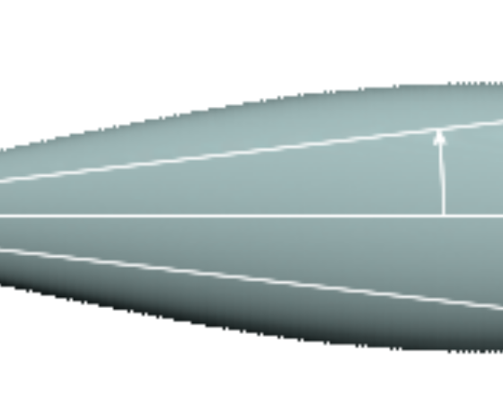
Angular Resolution (Beamwidth)
Separating Targets by Angle
If the radar beam is wide, two planes flying side-by-side will be illuminated simultaneously.
The radar will see one giant "blob." To distinguish them, the beamwidth must be narrower than the gap between the planes.

Slide 31
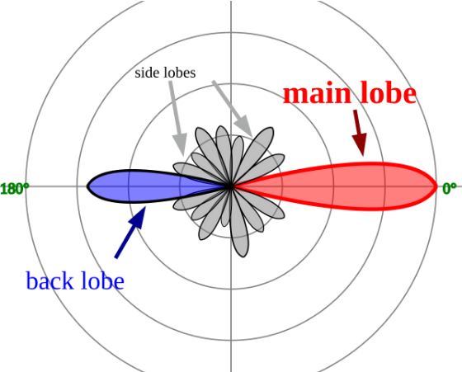
Antenna Sidelobes
Energy Leaks
Physics dictates that you cannot have a perfect beam. Some energy leaks out the sides (Sidelobes).
A strong target in a sidelobe can be mistaken for a target in the main beam, creating "Ghost Targets" in the wrong direction.

Slide 32
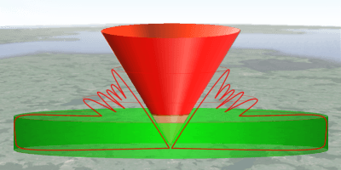
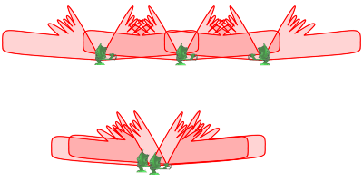
The Cone of Silence
The Overhead Blind Spot
Radars scan the horizon. They physically cannot look straight up.
This creates an inverted cone of blindness directly above the radar site. Aircraft flying directly overhead will disappear from the scope briefly.

Slide 33
3D Radar (Elevation)
Finding Height
2D radars (like airport surveillance) only give Range and Direction.
3D radars (Military/Weather) stack multiple beams vertically or steer the beam up/down to measure altitude.

Slide 34
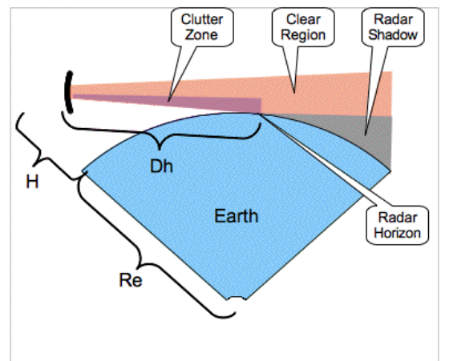
Line of Sight
Earth Curvature
Radar beams travel in straight lines. The Earth is curved.
At 100 miles away, the earth curves significantly. Low-flying aircraft can hide "under the radar horizon," invisible to the radar.

Slide 35
Terrain Masking
Shadow Zones
Radar beams cannot pass through mountains.
Any airspace behind a mountain range is a "Shadow Zone." Military pilots use this "Terrain Masking" to fly undetected.

Slide 36
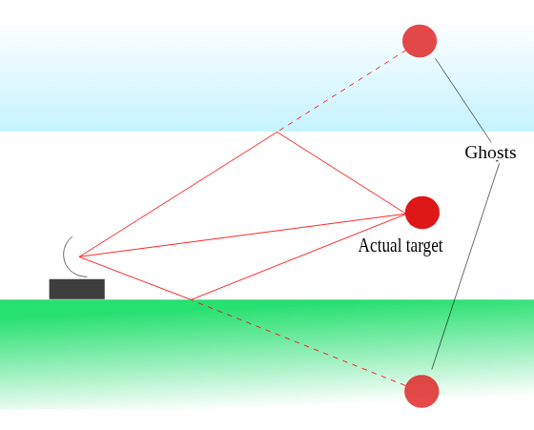
Multipath Effect
The Ghost Below
Radar beams can bounce off the sea or flat ground before hitting the target.
The radar sees two returns: the direct path and the longer "bounce" path. This confuses the altitude calculation, causing the target to jitter.

Slide 37
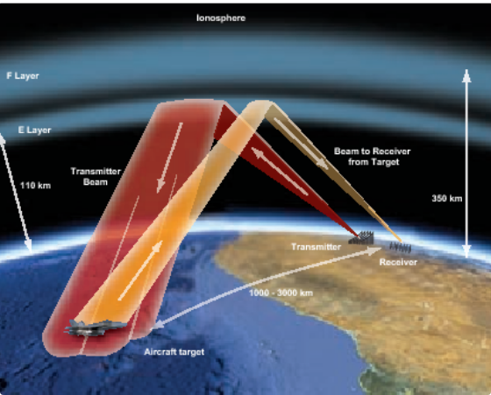
Ionosphere Scattering (OTHR)
Skywave Radar
High Frequency (HF) waves can bounce off the Ionosphere layer in the atmosphere.
This allows Over-The-Horizon Radar (OTHR) to see thousands of miles, detecting targets beyond the curvature of the Earth.

Slide 38
Radar Clutter
Ground Clutter
Sea Clutter
Volume Clutter
Reflections from buildings, mountains, and trees.
Reflections from waves (Sea State).
Reflections from rain, hail, or chaff.

Slide 39
The Doppler Effect
Detecting Motion
When a target moves toward the radar, the reflected frequency increases (Shift Up).
When it moves away, the frequency decreases (Shift Down). Radar uses this to measure speed instantly.

Slide 40
Speed Gating (Doppler Filters)
Filtering by Speed
Returns are sorted into "Doppler Bins" based on their shift.
Stationary objects (mountains) fall into the Zero-Velocity bin. Aircraft fall into High-Velocity bins. This allows us to erase the mountains electronically.

Slide 41
Moving Target Indication (MTI)
Seeing Only Motion
MTI radar ignores anything that isn't moving.
The Trade-off: It removes clutter, but it also hides stationary targets like hovering helicopters or balloons.

Slide 42
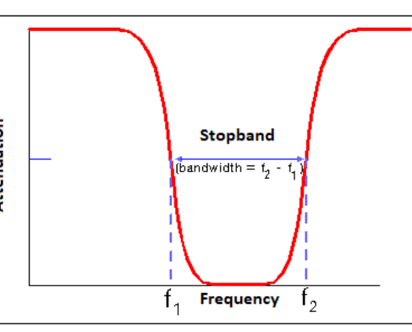
The Doppler Notch
Hiding in the Filter
If an aircraft flies perfectly perpendicular (90°) to the radar, its closing speed is zero.
The Doppler filter assumes it is a mountain and hides it. Pilots call this maneuver "Notching."

Slide 43

Blind Speeds
Sampling Errors
Due to the pulse timing (PRF), certain specific target speeds can align perfectly with the pulse rate.
At these speeds, the Doppler shift appears to be zero to the processor, making the target invisible.

Slide 44
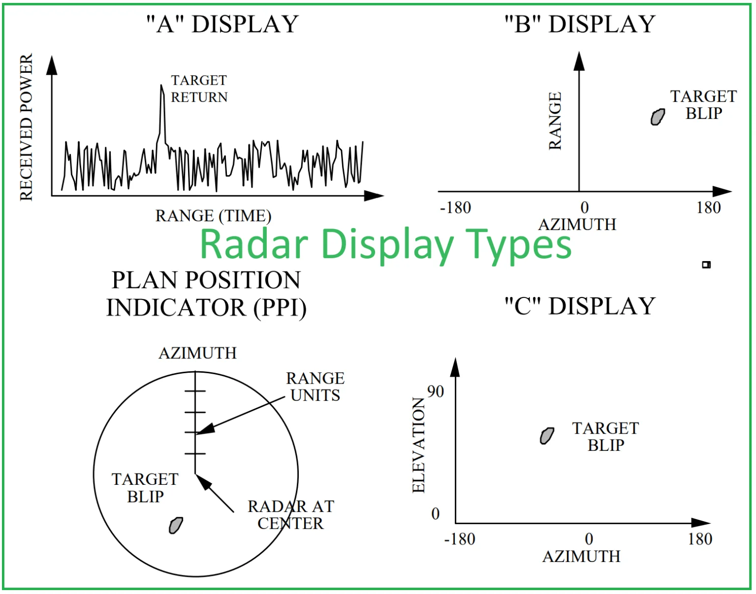
Radar Display Types
A-scope: Shows the amplitude (strength) of the echo signal versus the range or time. It is often used with other displays, like the PPI, for more detailed tracking.
B-scope: Displays azimuth angle against range. It shows targets within a selected range and can be used for surface radar.
C-scope: A rectangular display that shows azimuth angle on the horizontal axis and elevation angle on the vertical axis. It is often used in tracking radars.
PPI (Plan-Position Indicator): A circular display that shows a map-like view of targets. It plots the position of targets in polar coordinates, with the radar at the center, showing range (distance from the center) and azimuth (angle).

Slide 45
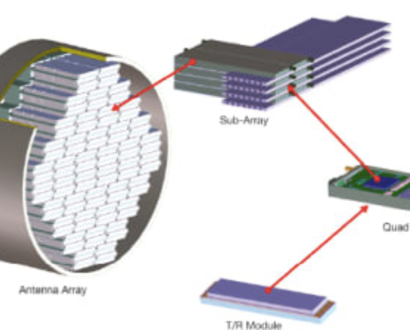
Phased Arrays (AESA)
No Moving Parts
Active Electronically Scanned Arrays do not spin.
They rely on interference patterns from thousands of tiny modules to "steer" the beam electronically.

Slide 46
AESA Advantages
Speed
Multi-Tasking
Reliability
Can scan the entire sky in milliseconds.
Can track a target and scan for new ones simultaneously.
If 10% of modules fail, the radar still works perfectly.

Slide 47
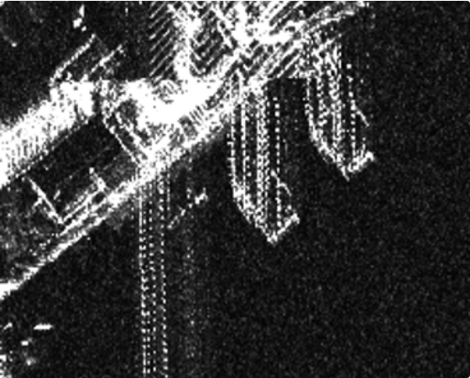
Synthetic Aperture Radar (SAR)
Radar Photography
By using the motion of the aircraft to simulate a huge antenna, SAR builds up photo-quality images of the ground.
Unlike optical cameras, SAR sees through clouds, smoke, and darkness.

Slide 48
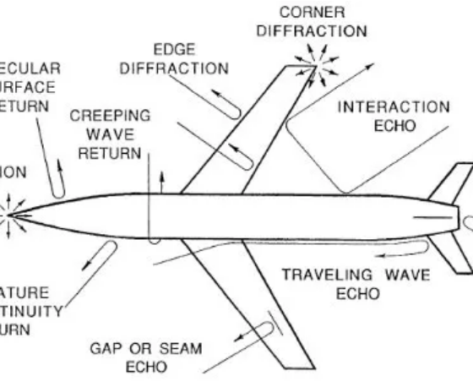
Stealth Technology
Defeating Radar
>
Geometry: Flat, angled surfaces deflect the beam away from the receiver.
>
RAM: Radar Absorbent Material traps the energy as heat.

Slide 49

Counter-Stealth
Can Radar See Stealth?
>
VHF Radar: Low frequency (long wavelength) radar can detect stealth aircraft due to resonance, but lacks accuracy to target them.
>
Bistatic Radar: Since stealth deflects energy away, a receiver placed far from the transmitter might catch the deflection.

Slide 50
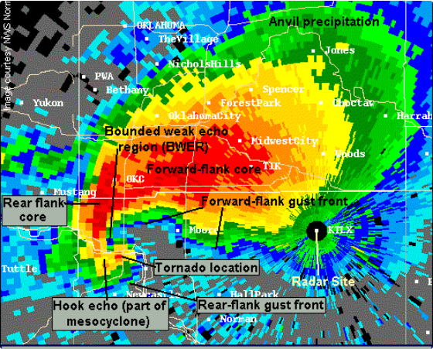
Weather Radar (NEXRAD)
Seeing the Rain
Weather radar detects water droplets. It uses Doppler to measure wind speed inside storms.
The Hook Echo: A specific shape on the screen that indicates the rotation of a potential tornado.

Slide 51
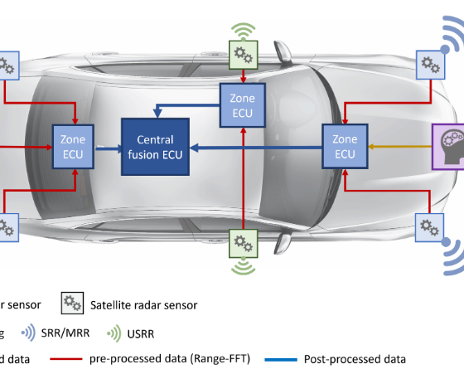
Automotive Radar
Safety Sensors
Used for Adaptive Cruise Control and Emergency Braking.
Uses FMCW (Frequency Modulated Continuous Wave) rather than pulses, allowing for very short-range detection.

Slide 52
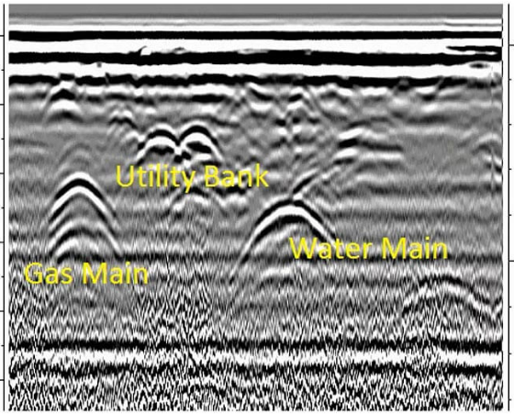
Ground Penetrating Radar (GPR)
Looking Underground
GPR fires pulses into the soil. It maps reflections from buried pipes, utility lines, and archaeological ruins.
Different soil types affect how deep it can see.

Slide 53



Final Summary
Heritage
Physics
Future
From acoustic mirrors to AESA.
Echoes, Doppler, and resolution limits.
Cognitive radar and AI integration.
QUESTIONS?

